Slide 1

Learning Objectives (1 of 2)
You will learn the following:
Overview of Role-Based Access Control (RBAC)
Role-based Access Control (RBAC) Roles
Azure AD Access Reviews
Implement and Configure an Azure Policy
Azure Blueprints

Slide 2
Overview of Role-Based Access Control (RBAC)

Slide 3
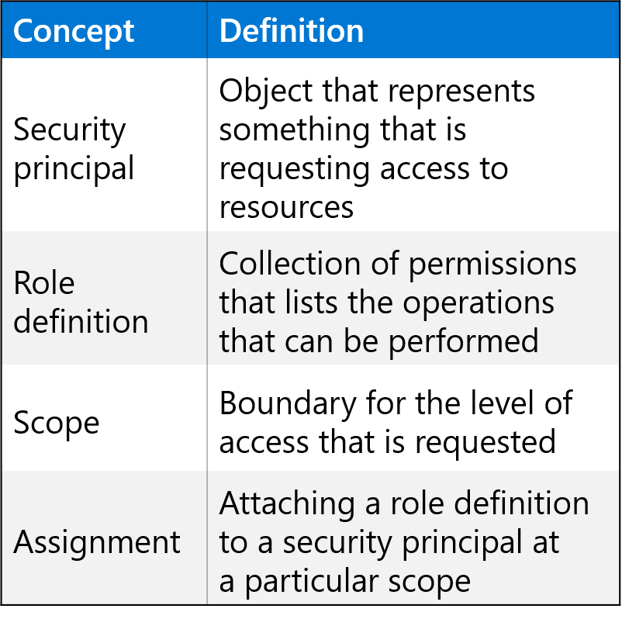
Role-Based Access Control (RBAC)
Provides fine-grained access management of resources in Azure​.
Built on Azure Resource Manager.
Segregate duties within your team.
Grant only the amount of access to users that they need to perform their jobs​.
Users can grant access described in a role definition by creating an assignment​.
Deny assignments are currently read-only and are set by Azure Blueprints and Azure Managed Apps.

Slide 4
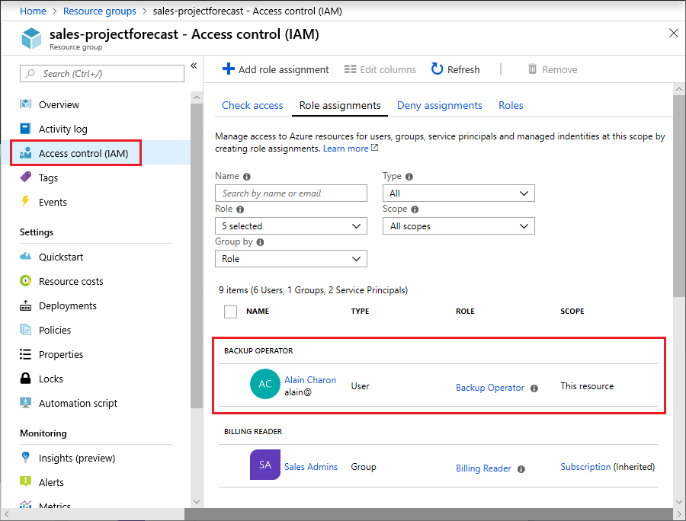
RBAC in the Azure Portal
An IAM pane for a resource group:

Slide 5
How RBAC Works (1 of 4)
You control access to resources using RBAC by creating role assignments
To create a role assignment, you need three elements
a security principal
a role definition
a scope
You can think of these elements as "who", "what", and "where".

Slide 6
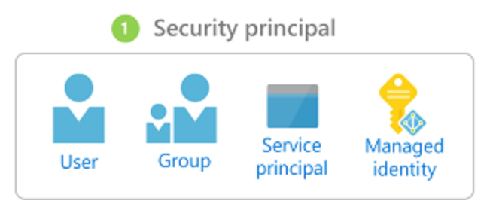
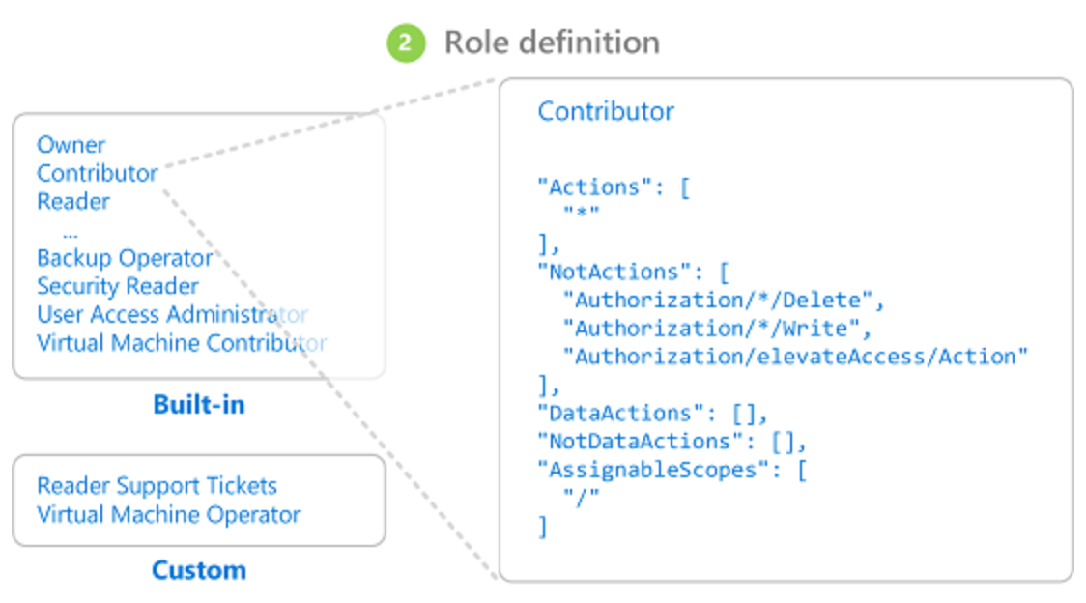
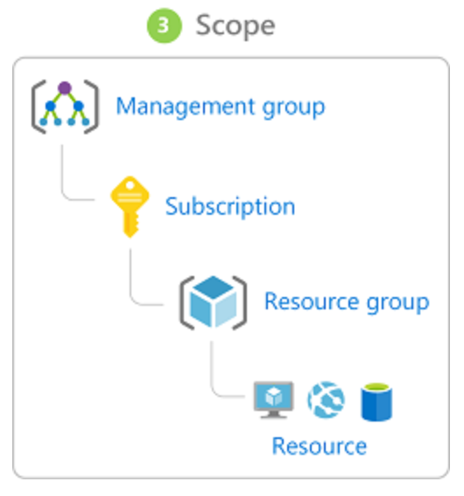
How RBAC Works (2 of 4)
Security principal
Role definition
Scope

Slide 7
How RBAC Works (3 of 4)
Collection of permissions that lists the operations that can be performed
Owner
Contributor
Reader
…
Backup Operator
Security Reader
User Access Administrator
Virtual Machine Contributor
"Actions": [
"*"
],
"NotActions" : [
"Authorization/*/Delete",
"Authorization/*/Write",
"Authorization/elevateAccess/Action"
],
"DataActions" : [],
"NotDataActions": [],
"AssignableScopes" : [
"/"
]
Built-in
Reader Support Tickets
Virtual Machine Operator
Custom
Contributor
Notes:
Describe the format and syntax of an Azure RBAC role definition.

Slide 8
How RBAC Works (4 of 4)
RBAC supports deny assignments:
Attaches a set of deny actions to a user, group, service principal, or managed identity at a particular scope for the purpose of denying access.
Deny assignments block users from performing specified actions even if a role assignment grants them access.
Deny assignments take precedence over role assignments.

Slide 9
Role-Based Access Control (RBAC)

Slide 10
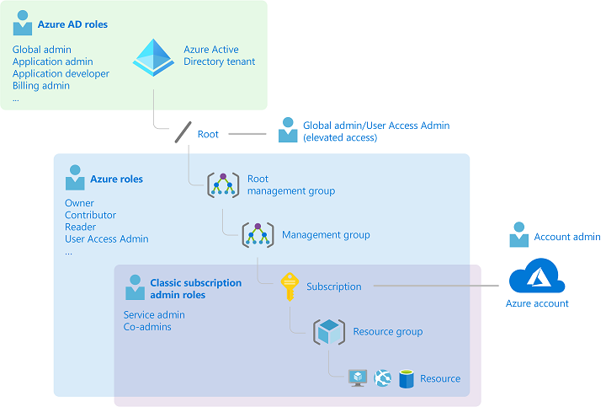
Administrator Roles, Azure Roles, and Azure AD Roles (1 of 4)
There are three general groups of roles in the context of Azure and Azure AD
Classic subscription administrator roles
Azure roles
Azure AD roles
How the roles are related

Slide 11
Administrator Roles, Azure Roles, and Azure AD Roles (2 of 4)
Classic subscription administration roles
Role | Limit | Permissions | Notes
Account Administrator | 1 per Azure account | Access the Azure Account Center Manage all subscriptions in an account Change the Service Administrator | The Account Administrator has no access to the Azure portal.
Service Administrator | 1 per Azure subscription | Manage services in the Azure portal Assign users to the Co-Administrator role | The Service Administrator has the equivalent access of a user who is assigned the Owner role at the subscription scope.
Co-Administrator | 200 per subscription | Same access privileges as the Service Administrator, but can’t change the association of subscriptions to Azure directories Assign users to the Co-Administrator role, but cannot change the Service Administrator | The Co-Administrator has the equivalent access of a user who is assigned the Owner role at the subscription scope.

Slide 12
Administrator Roles, Azure Roles, and Azure AD Roles (3 of 4)
Azure RBAC roles
Azure role | Permissions | Notes
Owner | Full access to all resourcesDelegate access to others | The Service Administrator and Co-Administrators are assigned the Owner role at the subscription scope Applies to all resource types.
Contributor | Create and manage all of types of Azure resources Create a new tenant in Azure Active Directory Cannot grant access to others | Applies to all resource types.
Reader | View Azure resources | Applies to all resource types.
User Access Administrator | Manage user access to Azure resources

Slide 13
Administrator Roles, Azure Roles, and Azure AD Roles (4 of 4)
Global Administrator (Azure AD Role)
The following permissions apply:
Manage access to all administrative features in Azure Active Directory, as well as services that federate to Azure Active Directory
Assign administrator roles to others
Reset the password for any user and all other administrators
User Administrator (Azure AD Role)
The following permissions apply:
Create and manage all aspects of users and groups
Manage support tickets
Monitor service health
Change passwords for users, Helpdesk administrators, and other User Administrators
Billing Administrator (Azure AD Role)
The following permissions apply:
Make purchases
Manage subscriptions
Manage support tickets
Monitors service health

Slide 14









RBAC Authentication
Azure AD
Admin roles
Azure Active
Directory tenant
Global admin
Application admin
Application developer
Billing admin
…
Global admin/User access admin (elevated access)
Root
Azure RBAC
roles
Root management group
Owner
Contributor
Reader
User access admin
…
Management group
Subscription
Azure RBAC
roles
Resource group
Azure account
Owner
Contributor
Reader
User access admin
…
Resource

Slide 15
Demonstration: Add an Azure Role Assignment
Add a role assignment

Slide 16
Azure AD Access Reviews

Slide 17

Azure AD Access Reviews
Why are access reviews important?
When to use access reviews?
Where do you create reviews?
Access rights of users | Reviewers can be | Review created in | Reviewer experience
Security group members Office group members | Specified reviewers Group owners Self-review | Azure AD access reviews Azure AD groups | Access panel
Assigned to a connected app | Specified reviewers Self-review | Azure AD access reviews Azure AD enterprise apps (in preview) | Access panel
Azure AD role | Specified reviewers Self-review | Azure AD PIM | Azure portal
Azure resource role | Specified reviewers Self-review | Azure AD PIM | Azure portal

Slide 18
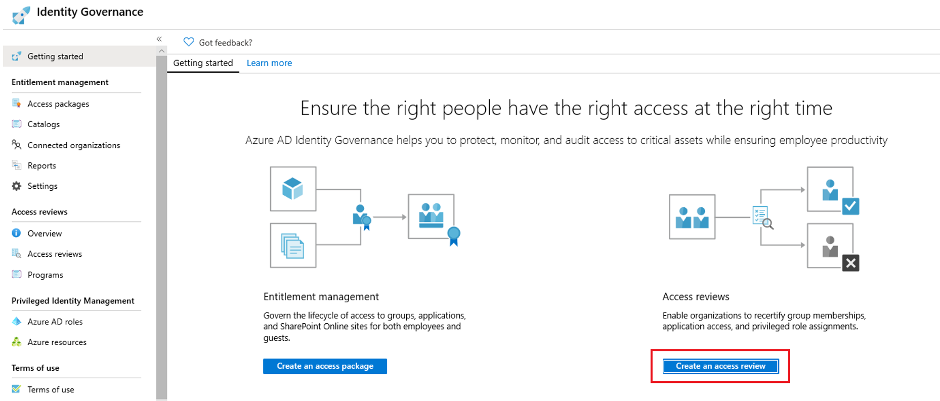
Create an Azure AD Access Review
Manage access reviews in Azure portal

Slide 19
Implement and Configure an Azure Policy

Slide 20
Azure Policy Overview (1 of 2)
How are Azure Policy and RBAC different
Applying a policy
Create a policy definition
Assign a definition to a scope of resources
View policy evaluation results
What is a policy definition?
Allowed storage account SKUs
Allowed resource type
Allowed locations
Allowed virtual machine SKUs
Not allowed resource types

Slide 21
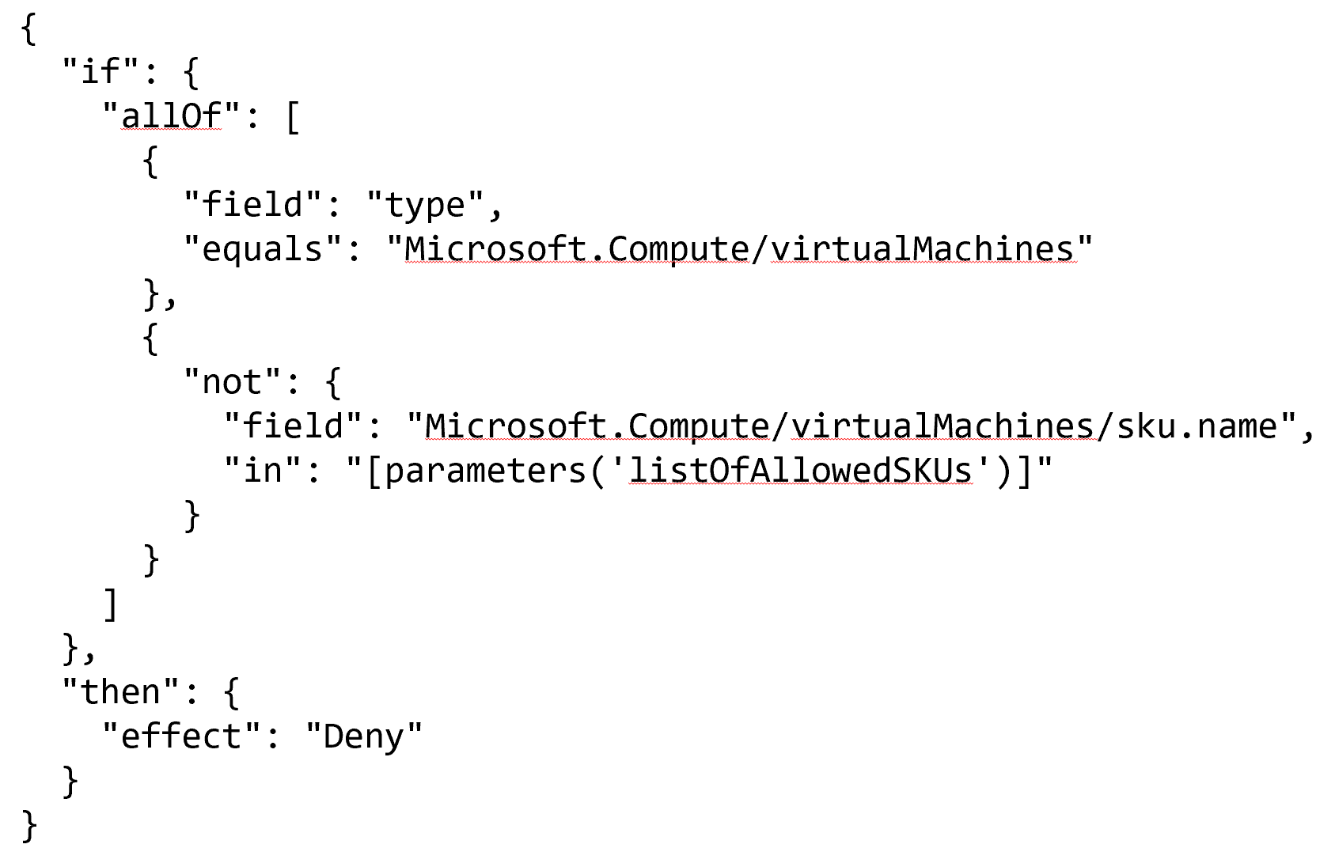
Azure Policy Overview (2 of 2)

Slide 22
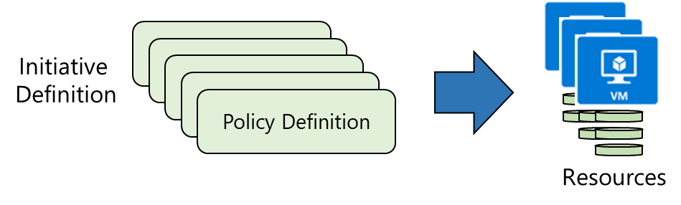
Azure Initiative Definitions
Browse policy definitions
Create initiative definitions
Scope the initiative definition
View Policy evaluation results
Notes:
The next topics step you through creating an Azure policy.
Note: Even if you have only a few policy definitions, we recommend creating an initiative definition.

Slide 23
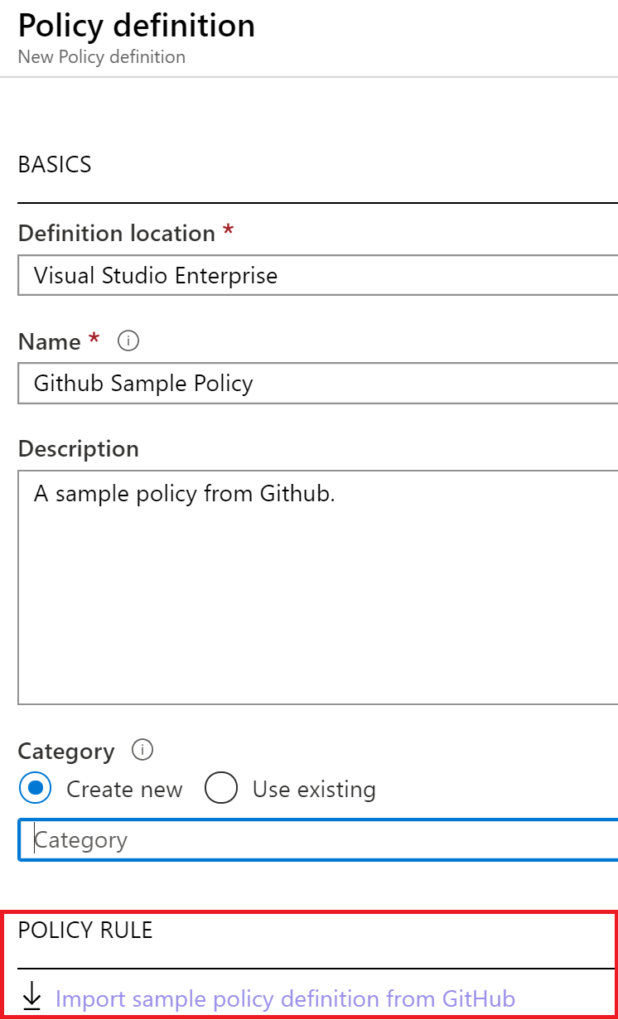
Policy Definitions
Many policy definitions are available.
You can import policies from GitHub.
Policy definitions have a specific JSON format.
You can create custom policy definitions.

Slide 24
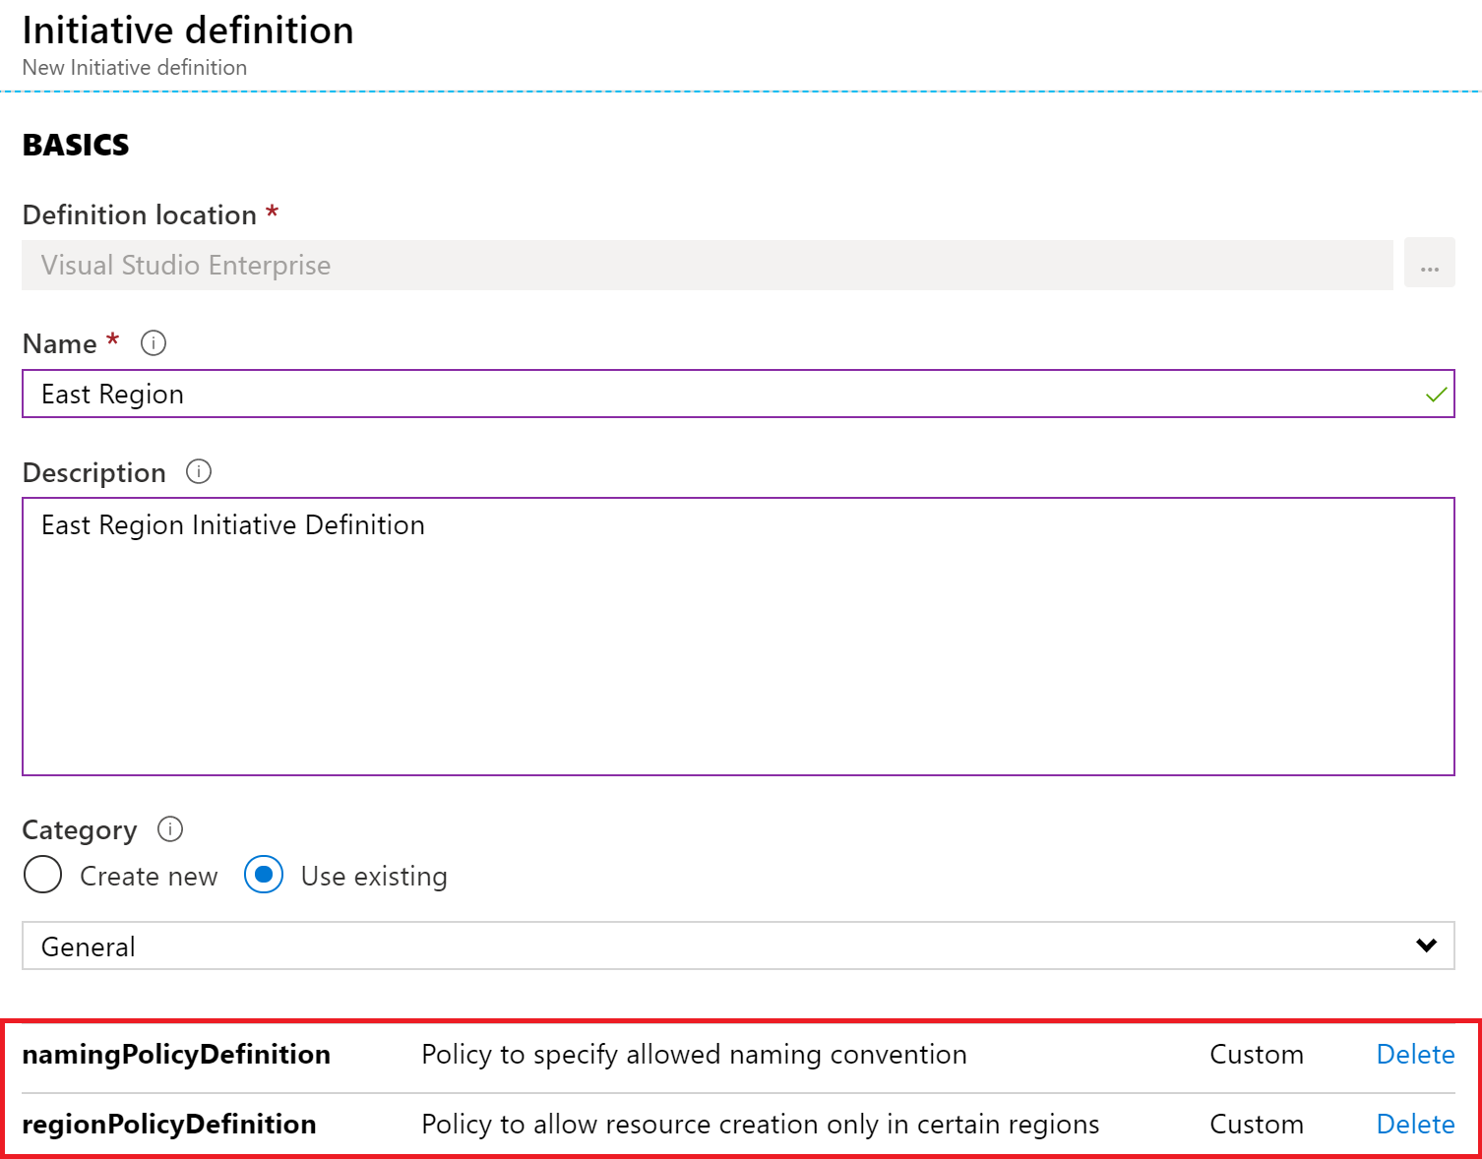
Create Initiative Definitions
Group policy definitions
Include one or more policies
Requires planning
Notes:
Suggested discussion topic: Can you see how this will require some planning to organize your policies?

Slide 25
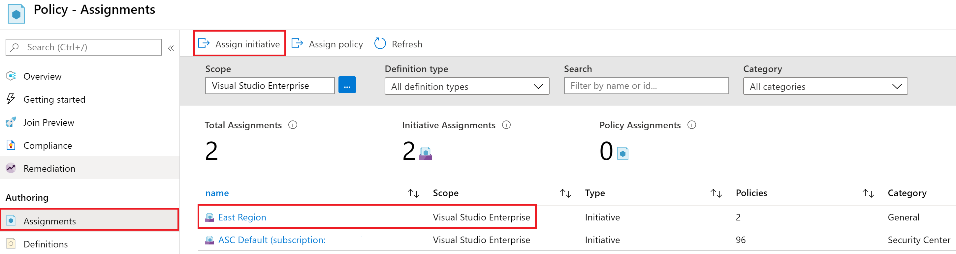
Scope the Initiative Definition
Assign the definition to a scope
The scope enforces the policy
Select the subscription, and optionally the resource group
Notes:
Note: Currently, an Initiative Definition can have up to 100 policies.

Slide 26
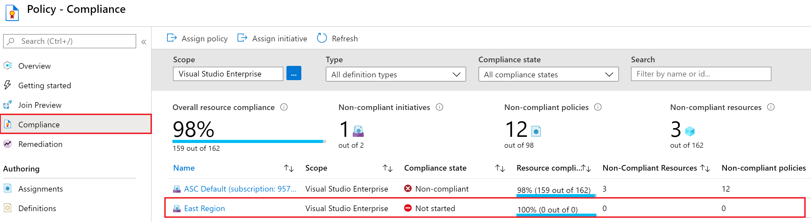
Determine Compliance
Non-compliant initiatives
Non-compliant policies
Non-compliant resources
Notes:
Policy evaluation happens about once an hour, which means that if you make changes to your policy definition and create a policy assignment then it will be re-evaluated over your resources within the hour.

Slide 27
Demonstration: Create and Manage Policies to Enforce Compliance
Assign a policy

Slide 28
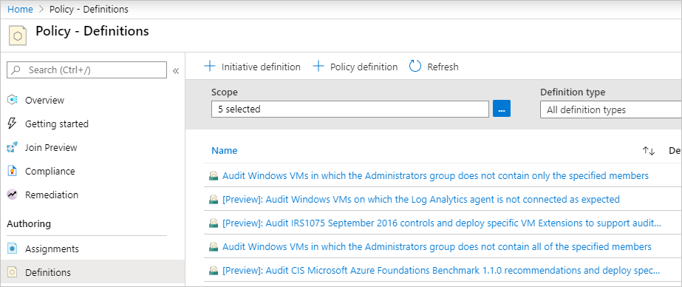
Implement a New Custom Policy
Scenario: create a new custom policy to save costs by validating that VMs created in your environment can't be in the G series.
Every time a user in your organization tries to create VM in the G series, the request is denied.

Slide 29
Azure Blueprints

Slide 30
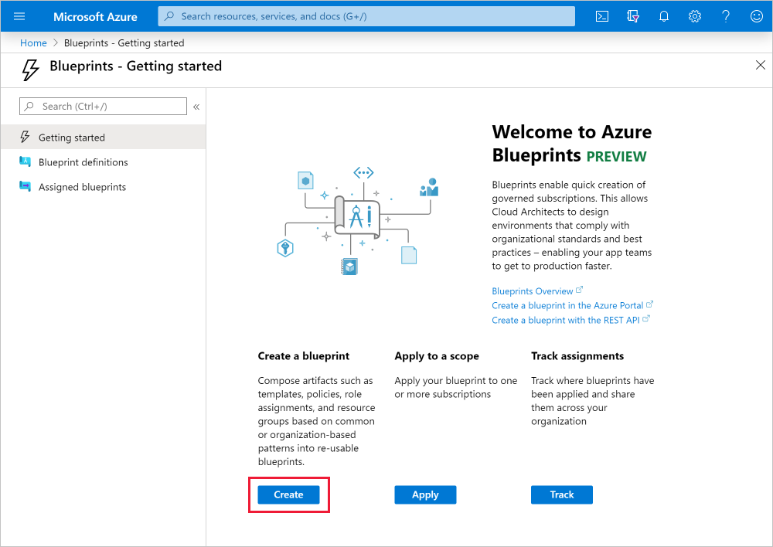
Azure Blueprints
Azure Blueprints is a declarative way to orchestrate the deployment of such artifacts as policy
Role assignments
Policy assignments
ARM templates
Resource groups
How is this different from ARM templates
How is this different from Azure policy

Slide 31
Azure Policy vs. Azure Blueprints
Azure Policy
Azure Blueprints
Helps to enforce organizational standards and to assess compliance at-scale
Provides an aggregated view to evaluate the overall state of the environment
Helps to bring your resources to compliance through bulk remediation for existing resources and automatic remediation for new resources
Enables cloud architects and central information technology groups to define a repeatable set of Azure resources that implements and adheres to an organization's standards, patterns, and requirements
Makes it possible for development teams to rapidly build and stand up new environments with trust they're building within organizational compliance

Slide 32
Demonstration: Create a Blueprint
Create a blueprint

Slide 33
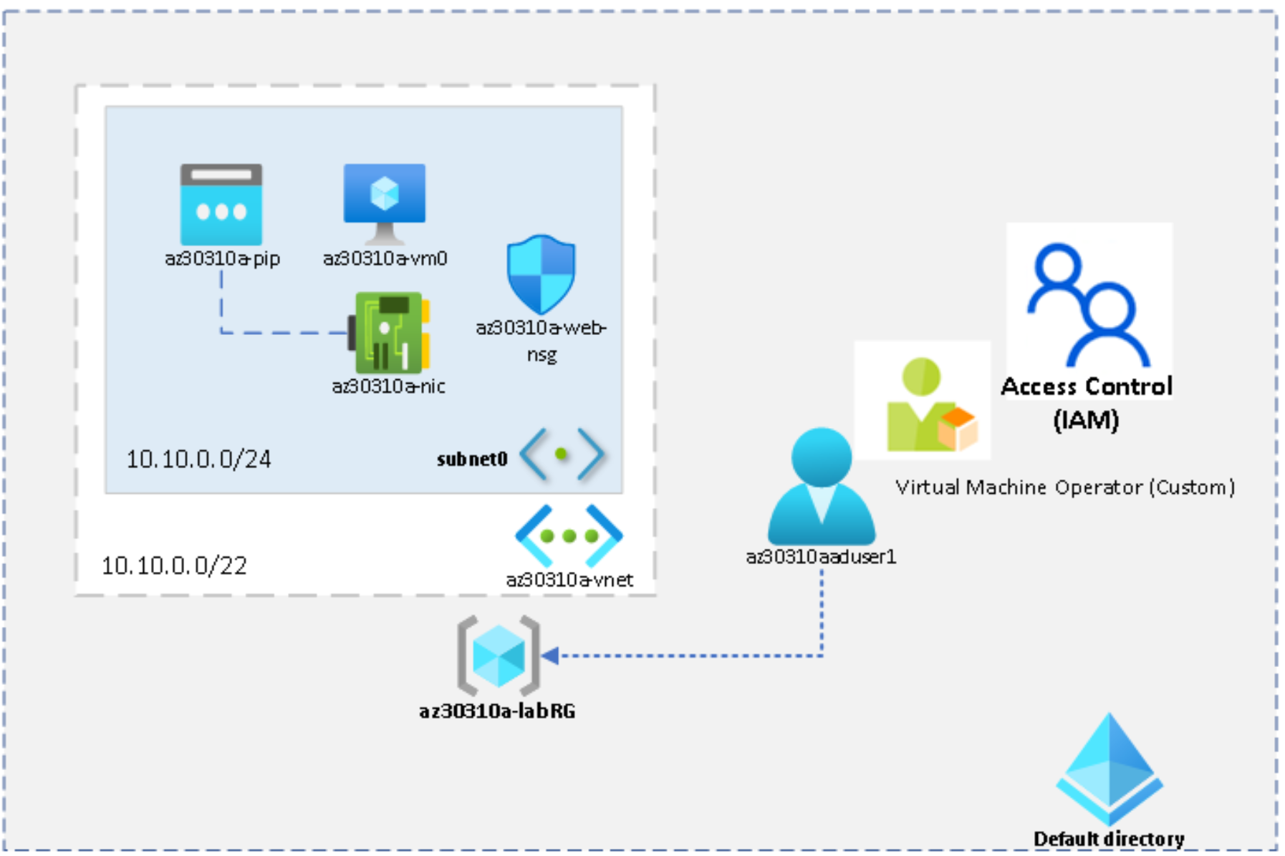
Lab: Managing Azure Role-Based Access Control

Slide 34

Module Review Questions

